Slide 1
3:10-17

Slide 2
3:10-17
Heb. 4:13 ~ And there is no creature hidden from His sight, but all things are naked and open to the eyes of Him to whom we must give account.

Slide 3
3:10-17

Slide 4
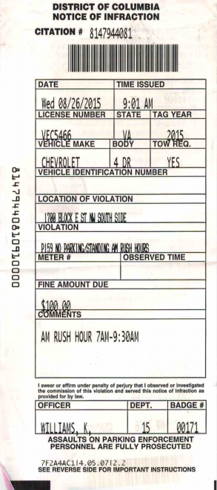
3:10-17
3:10-17
City of Oklahoma City Notice of Infraction
“I’ve circled this block for 10 years. If I don’t give you a ticket, I’ll lose my job. LEAD US NOT INTO TEMPTATION.”
“I have circled the block 100 times. If I don’t park here, I’ll miss my appointment. FORGIVE US OUR TRESPASSES.”

Slide 5
3:10-17

Slide 6
3:10-17
2 Timothy 3:10-17 ~ ¹⁰ But you have carefully followed my doctrine, manner of life, purpose, faith, longsuffering, love, perseverance, ¹¹ persecutions, afflictions, which happened to me at Antioch, at Iconium, at Lystra—what persecutions I endured. And out of them all the Lord delivered me. ¹² Yes, and all who desire to live godly in Christ Jesus will suffer persecution. ¹³ But evil men and impostors will grow worse and worse, deceiving and being deceived. ¹⁴ But you must continue in the things which you have learned and been assured of, knowing from
whom you have learned them,

Slide 7
3:10-17
2 Timothy 3:10-17 ~ ¹⁵ and that from childhood you have known the Holy Scriptures, which are able to make you wise for salvation through faith which is in Christ Jesus.
¹⁶ All Scripture is given by inspiration of God, and is profitable for doctrine, for reproof, for correction, for instruction in righteousness, ¹⁷ that the man of God may be complete, thoroughly equipped for every good work.

Slide 8
3:10-17

Slide 9
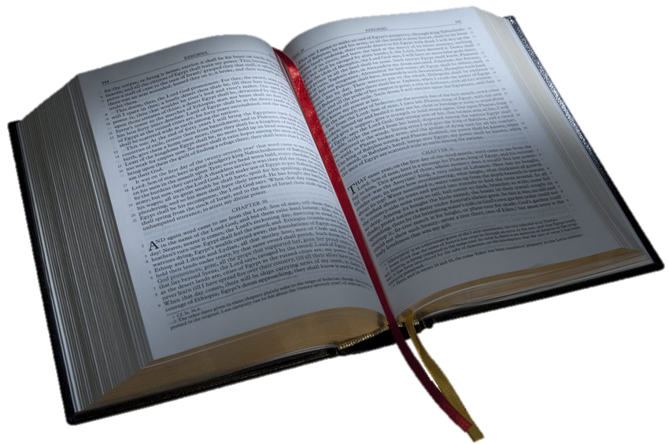
3:10-17
1. Is it resolute? (authoritative)
2. Is it relevant? (contemporary)
3. Is it reliable? (trustworthy)

Slide 10
3:10-17

Slide 11
3:10-17
If the Bible had been written by college students:
Instead of God creating the world in six days and resting on the seventh, He would have put it off until the night before it was due and then pulled an all-nighter.
The Last Supper would have been eaten the next morning – cold.
Forbidden fruit would have been eaten because it wasn’t cafeteria food.

Slide 12
3:10-17
If the Bible had been written by college students:
The Ten Commandments would actually be only five –
large font.
double-spaced and written in a
Paul’s letter to the Romans would become Paul’s email to abuse@romans.gov.
Reason Cain killed Abel: they were roommates.
Reason why Moses and followers walked in the desert for 40 years: they didn’t want to ask directions and look like freshmen.

Slide 13
3:10-17
1. Is it resolute? (authoritative)

Slide 14
3:10-17

Slide 15
3:10-17
perseverance ~ hupomonē – patience, endurance

Slide 16
3:10-17

Slide 17
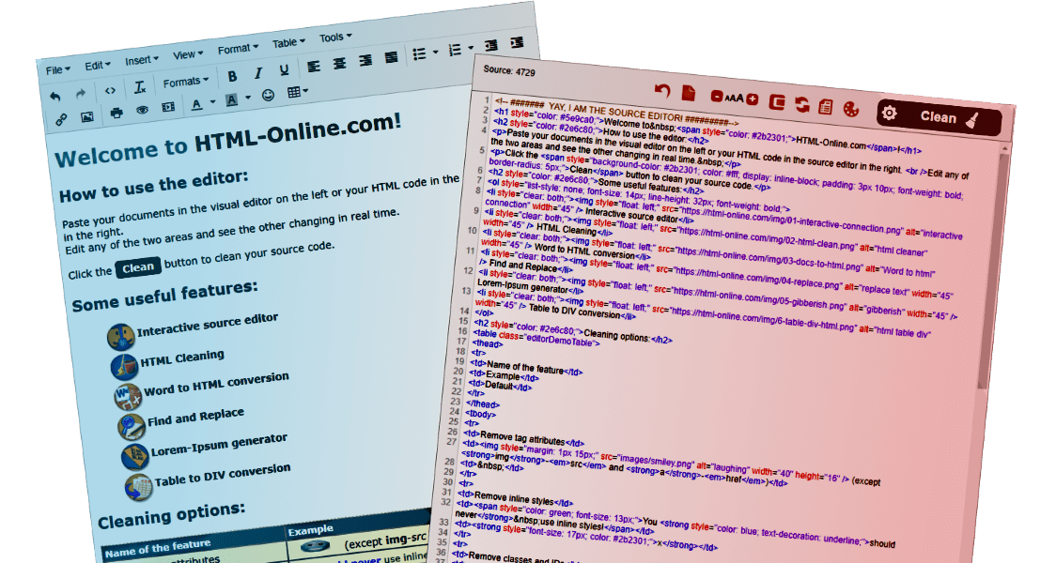
3:10-17
WYSIWYG ~ “What you see is what you get”

Slide 18
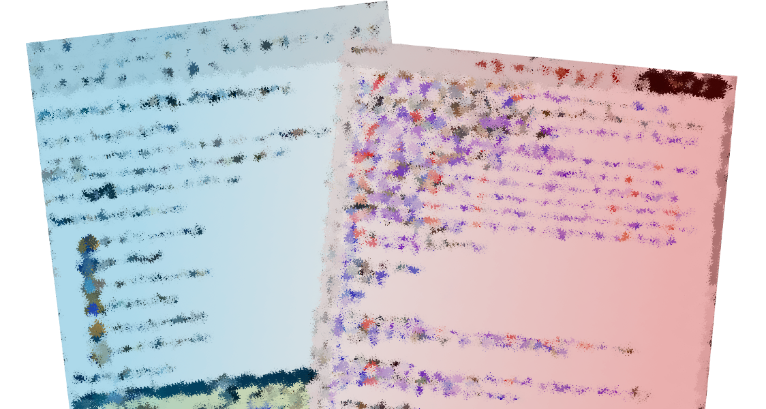
3:10-17
WYSIWYG ~ “What you see is what you get”

Slide 19
3:10-17

Slide 20
3:10-17
1 Cor. 11:1 ~ Imitate me just as I also imitate Christ.

Slide 21
3:10-17

Slide 22
3:10-17
“Yes, and all who desire to live godly in Christ Jesus will suffer persecution.” – 2 Timothy 3:13
“For thou, Lord, art good, and ready to forgive; and plenteous in mercy unto all them that call upon thee.”
– Exodus 14:14
The righteous cry out, and the LORD hears them; he delivers them from all their troubles..
– Psalms 34:17
“But my God shall supply all your need according to his riches in glory by Christ Jesus.”
– Exodus 14:14
“Wait on the Lord: be of good courage, and he shall strengthen thine heart;”
– Psalm 27:14b
“There is a friend that sticketh closer than a brother.”
– Proverbs 18:24
“And we know that in all things God works for the good of those who love him,”
– Romans 8:28a
He giveth power to the faint; and to them that have no might he increaseth strength.
– Exodus 14:14

Slide 23
3:10-17

Slide 24
3:10-17
Ignatius (AD 35-110, bishop of Antioch) ~ “O that I were already with the beasts, which are ready to devour me! Now only I begin to be a disciple of Christ. I regard neither things visible nor invisible, at which the world is amazed. It is sufficient for me if I but become a partaker of Christ. Let the devil and evil men afflict me with all manner of pain and torment, with fire, with cross, with fighting against wild beasts, with scattering of the members of my body; all this I esteem very little, if I but enjoy Christ.”

Slide 25
3:10-17
Ignatius (AD 35-110, bishop of Antioch) ~ “I am the grain of God. I am ground by the teeth of the beast, that I may be found a pure bread of Christ, who is to me the bread of life.”

Slide 26
3:10-17
Kuwa Bashir (Sudanese youth leader) ~
“If I die or am shot dead, I will be very happy because I will leave an example for other Christians to follow in my steps. I will die without fear like Jesus on the cross.”

Slide 27
3:10-17

Slide 28
3:10-17
suffer persecution ~ diōkō – to follow after

Slide 29
3:10-17

Slide 30
3:10-17
1. Is it resolute? (authoritative)
2. Is it relevant? (contemporary)

Slide 31
3:10-17

Slide 32
3:10-17
impostors ~ KJV, seducers - enchanters

Slide 33
3:10-17

Slide 34
3:10-17
Holy Scriptures ~ heira grammata – sacred writings

Slide 35
3:10-17

Slide 36
3:10-17
Ponchus
the Pilot
Baby Jesus
Mary
Josuff
The flite to Egippt

Slide 37
3:10-17

Slide 38
3:10-17
1. Is it resolute? (authoritative)
2. Is it relevant? (contemporary)
3. Is it reliable? (trustworthy)

Slide 39
3:10-17

Slide 40
3:10-17
given by inspiration of God ~ theopneustos – God-breathed
theos ~ God – pneuma ~ spirit, wind or breath

Slide 41
3:10-17

Slide 42
3:10-17
Cell membrane
Nucleus
Cytoplasm
The “Simple Cell”
The “Primitive Cell”

Slide 43
3:10-17

Slide 44
3:10-17
“Scott owes me one thousand dollars”
The overwhelming majority of the manuscripts
“‘Scotts owe’ me one thousand dollars”
A few later ones say “Scotts owe”
“Scott ‘owns’ me one thousand dollars”
A few other late ones read “owns”
“Scott ‘owes my’ one thousand dollars”
A very few much later ones say “owes my”

Slide 45
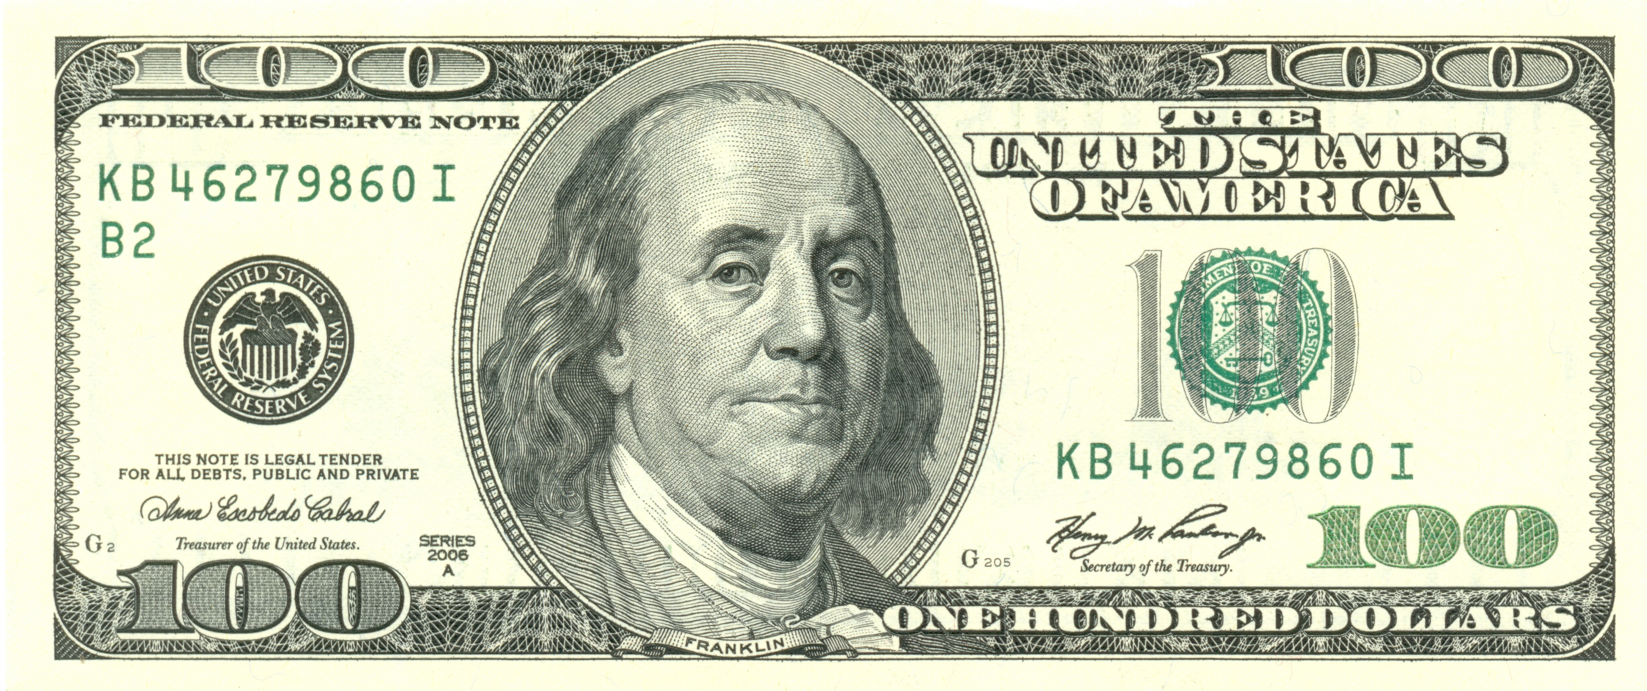
3:10-17

Slide 46
3:10-17

Slide 47
3:10-17
Mark Twain ~ “Most people are bothered by those passages of Scripture they do not understand, but the passages that bother me are those I do understand.”

Slide 48
3:10-17

Slide 49
3:10-17

Slide 50
3:10-17

Slide 51
3:10-17
Elisabeth Elliot ~ “The Word of God I think of as a straight edge, which shows up our own crookedness. We can’t really tell how crooked our thinking is until we line it up with the straight edge of Scripture.”

Slide 52
3:10-17

Slide 53
3:10-17
Ps 119:105 ~ Your word is a lamp to my feet
And a light to my path.
Ps. 119:9 ~ How can a young man cleanse his way?
By taking heed according to Your word.

Slide 54
3:10-17

